Slide 1
OPS & Diamond Eurofer Steel Surface Removal
A. Wylie

Slide 2
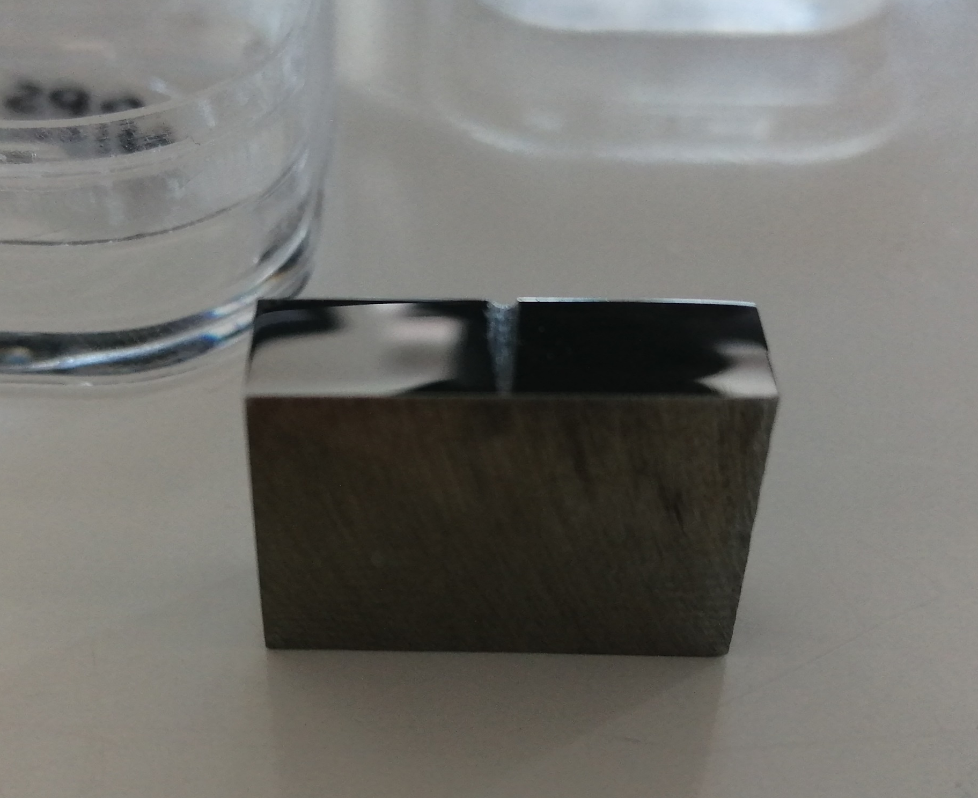
OPS Study
Wish to preserve as much of c. 15 micron proton irradiated layer as is possible
Eurofer weld base material cut-off polished to OPS finish
Roughly same surface area as welded samples
Groove scratched in for OPS study as reference point
Surface analysis using NanoFocus µScan Custom laser profiler
Hand-polished OPS (undiluted 40 nm) at 10 minute intervals
2-D profile comparison

Slide 3
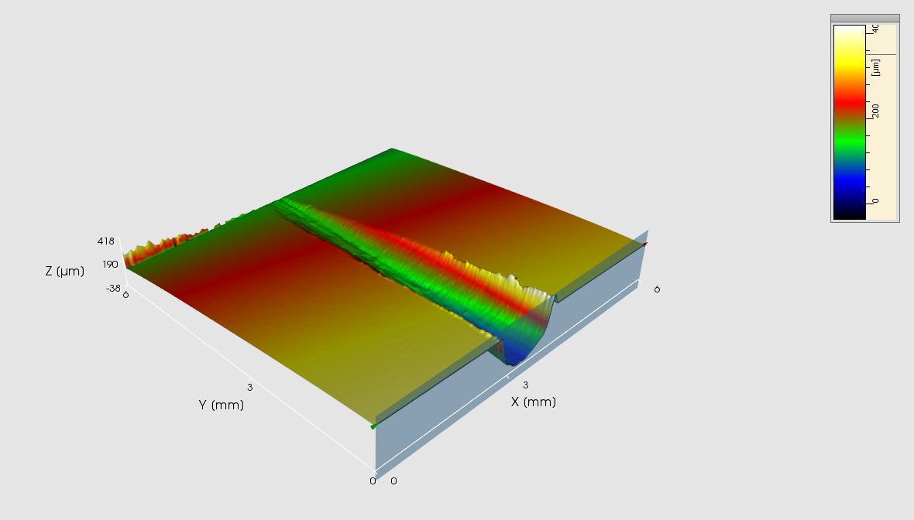
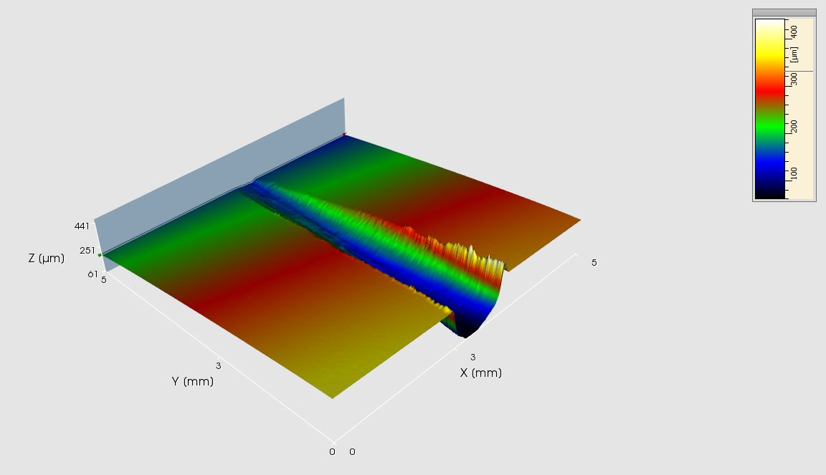
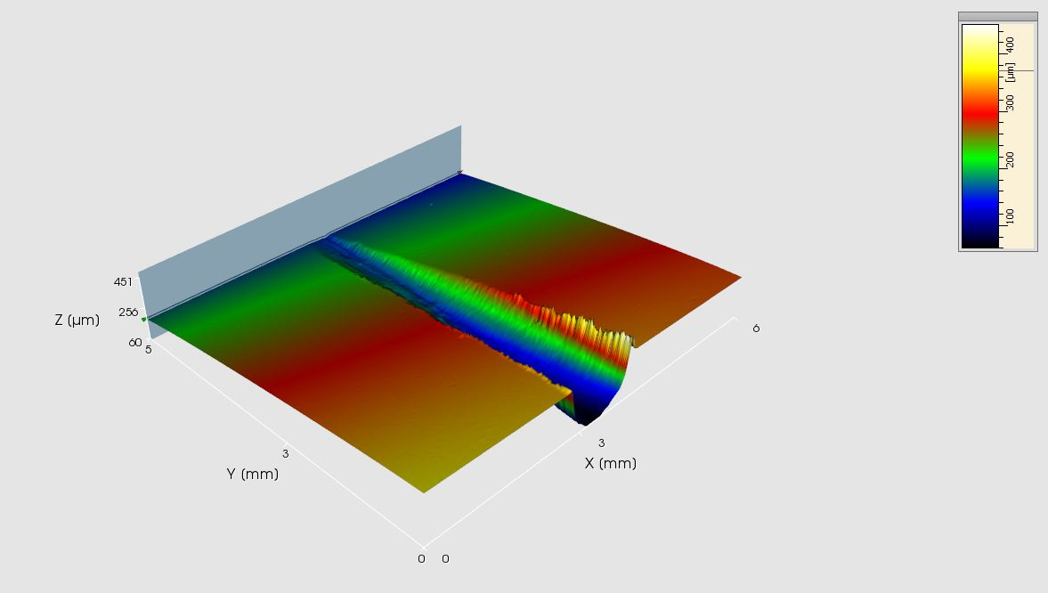
As grooved
10 min OPS
20 min OPS
OPS Polishing Time /mins | Trough height/um | Plane height /um | Difference /um | Removed thickness/um
0 | -218 | 29.5 | 247.5
10 | -217 | 29 | 246 | 1.5
20 | -219 | 27.3 | 246.3 | -0.3
Error of 1.4 um => erosion not observable
≤ 1.4 um erosion

Slide 4
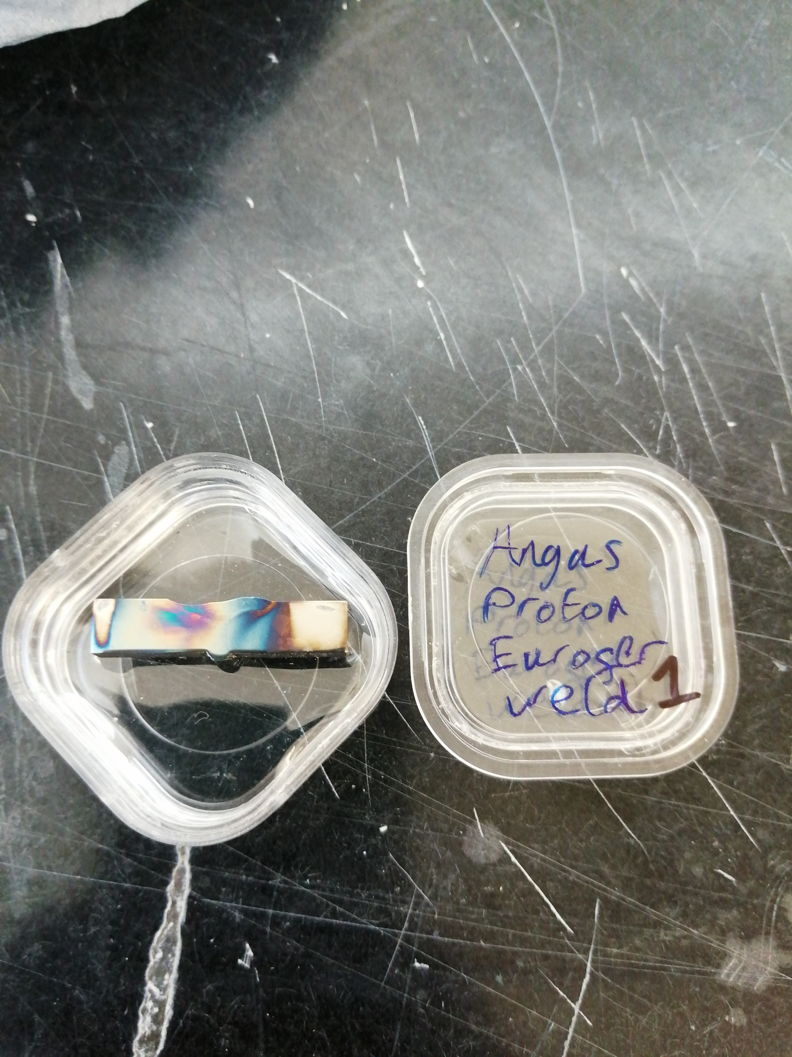
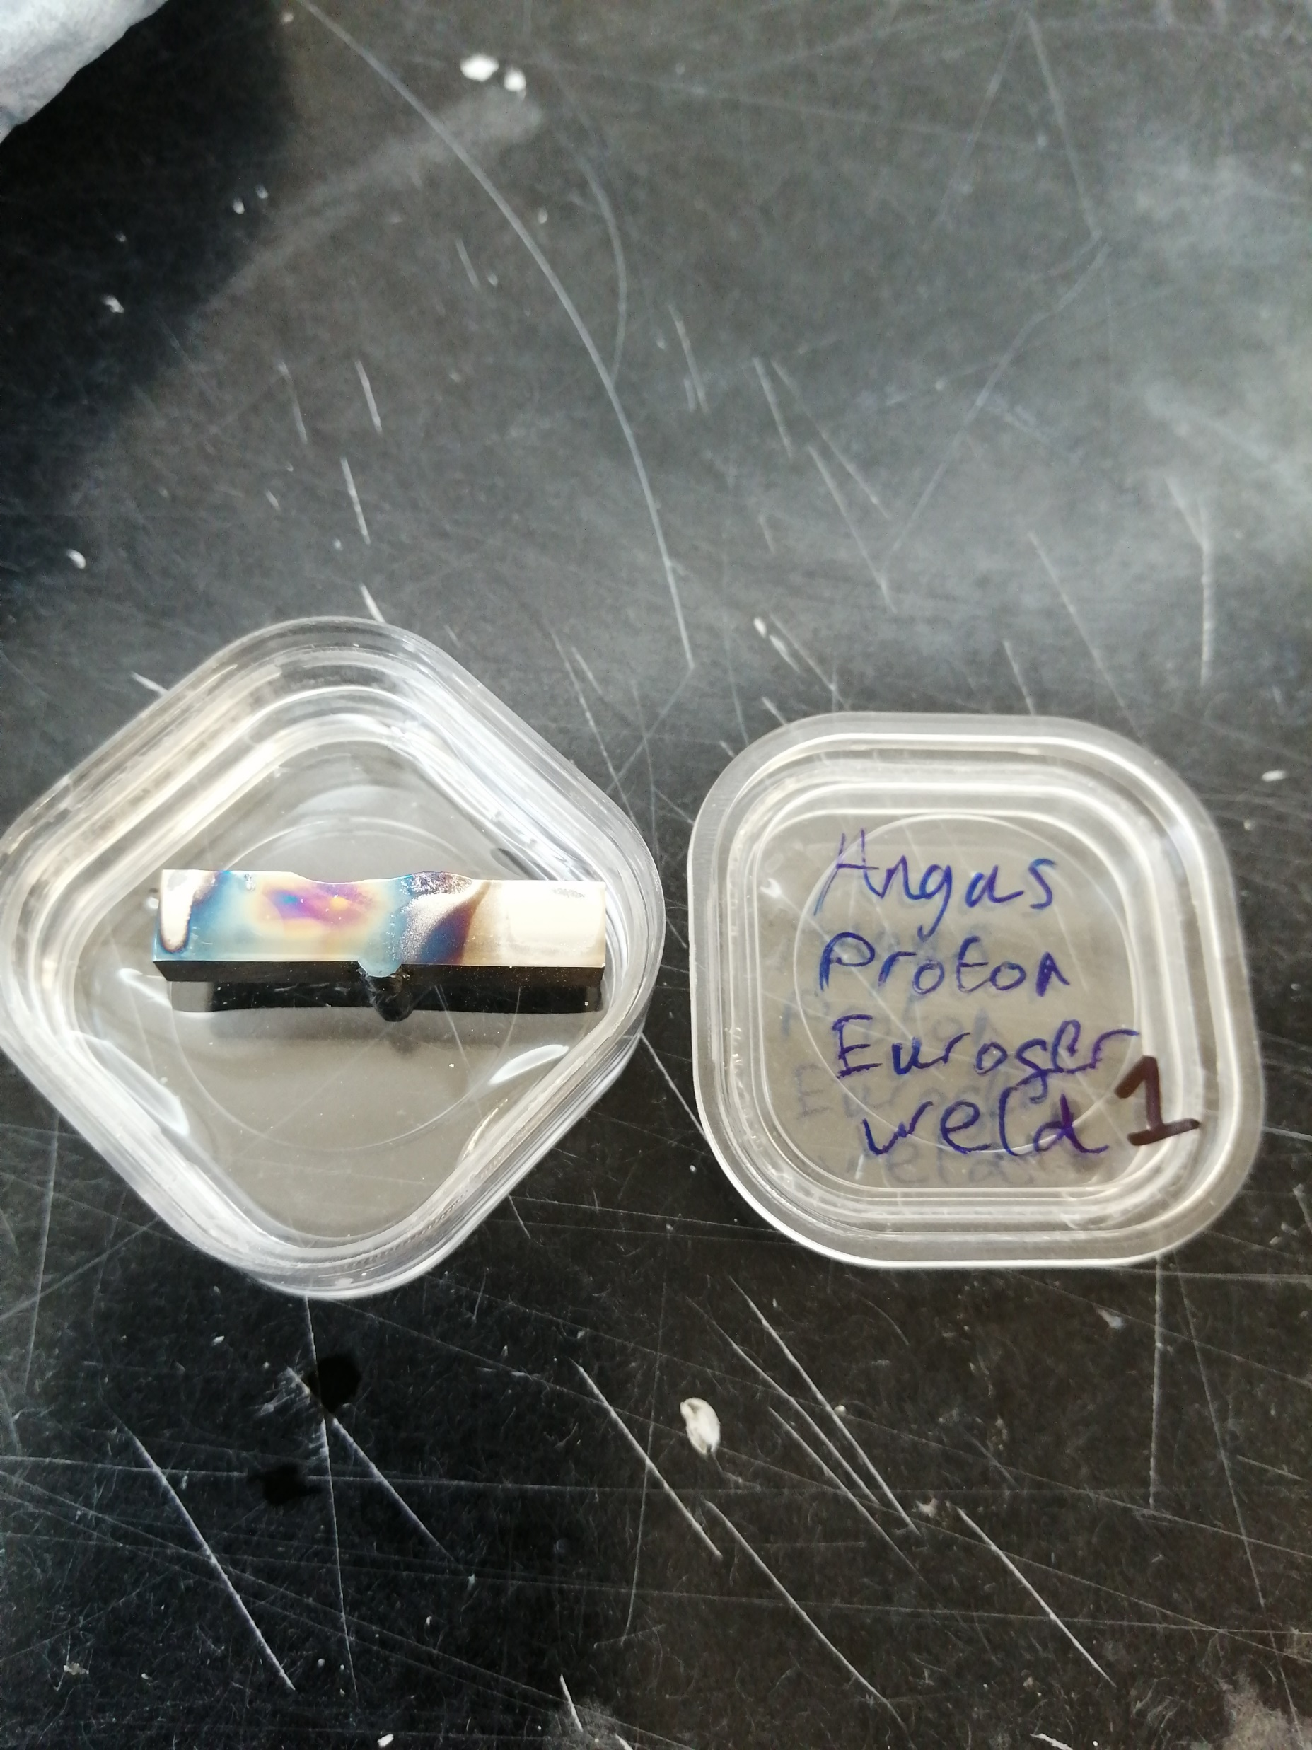
Trying to remove proton irradiation staining
As-received
3-minute hand-OPS 40 nm
=> Not enough removed

Slide 5
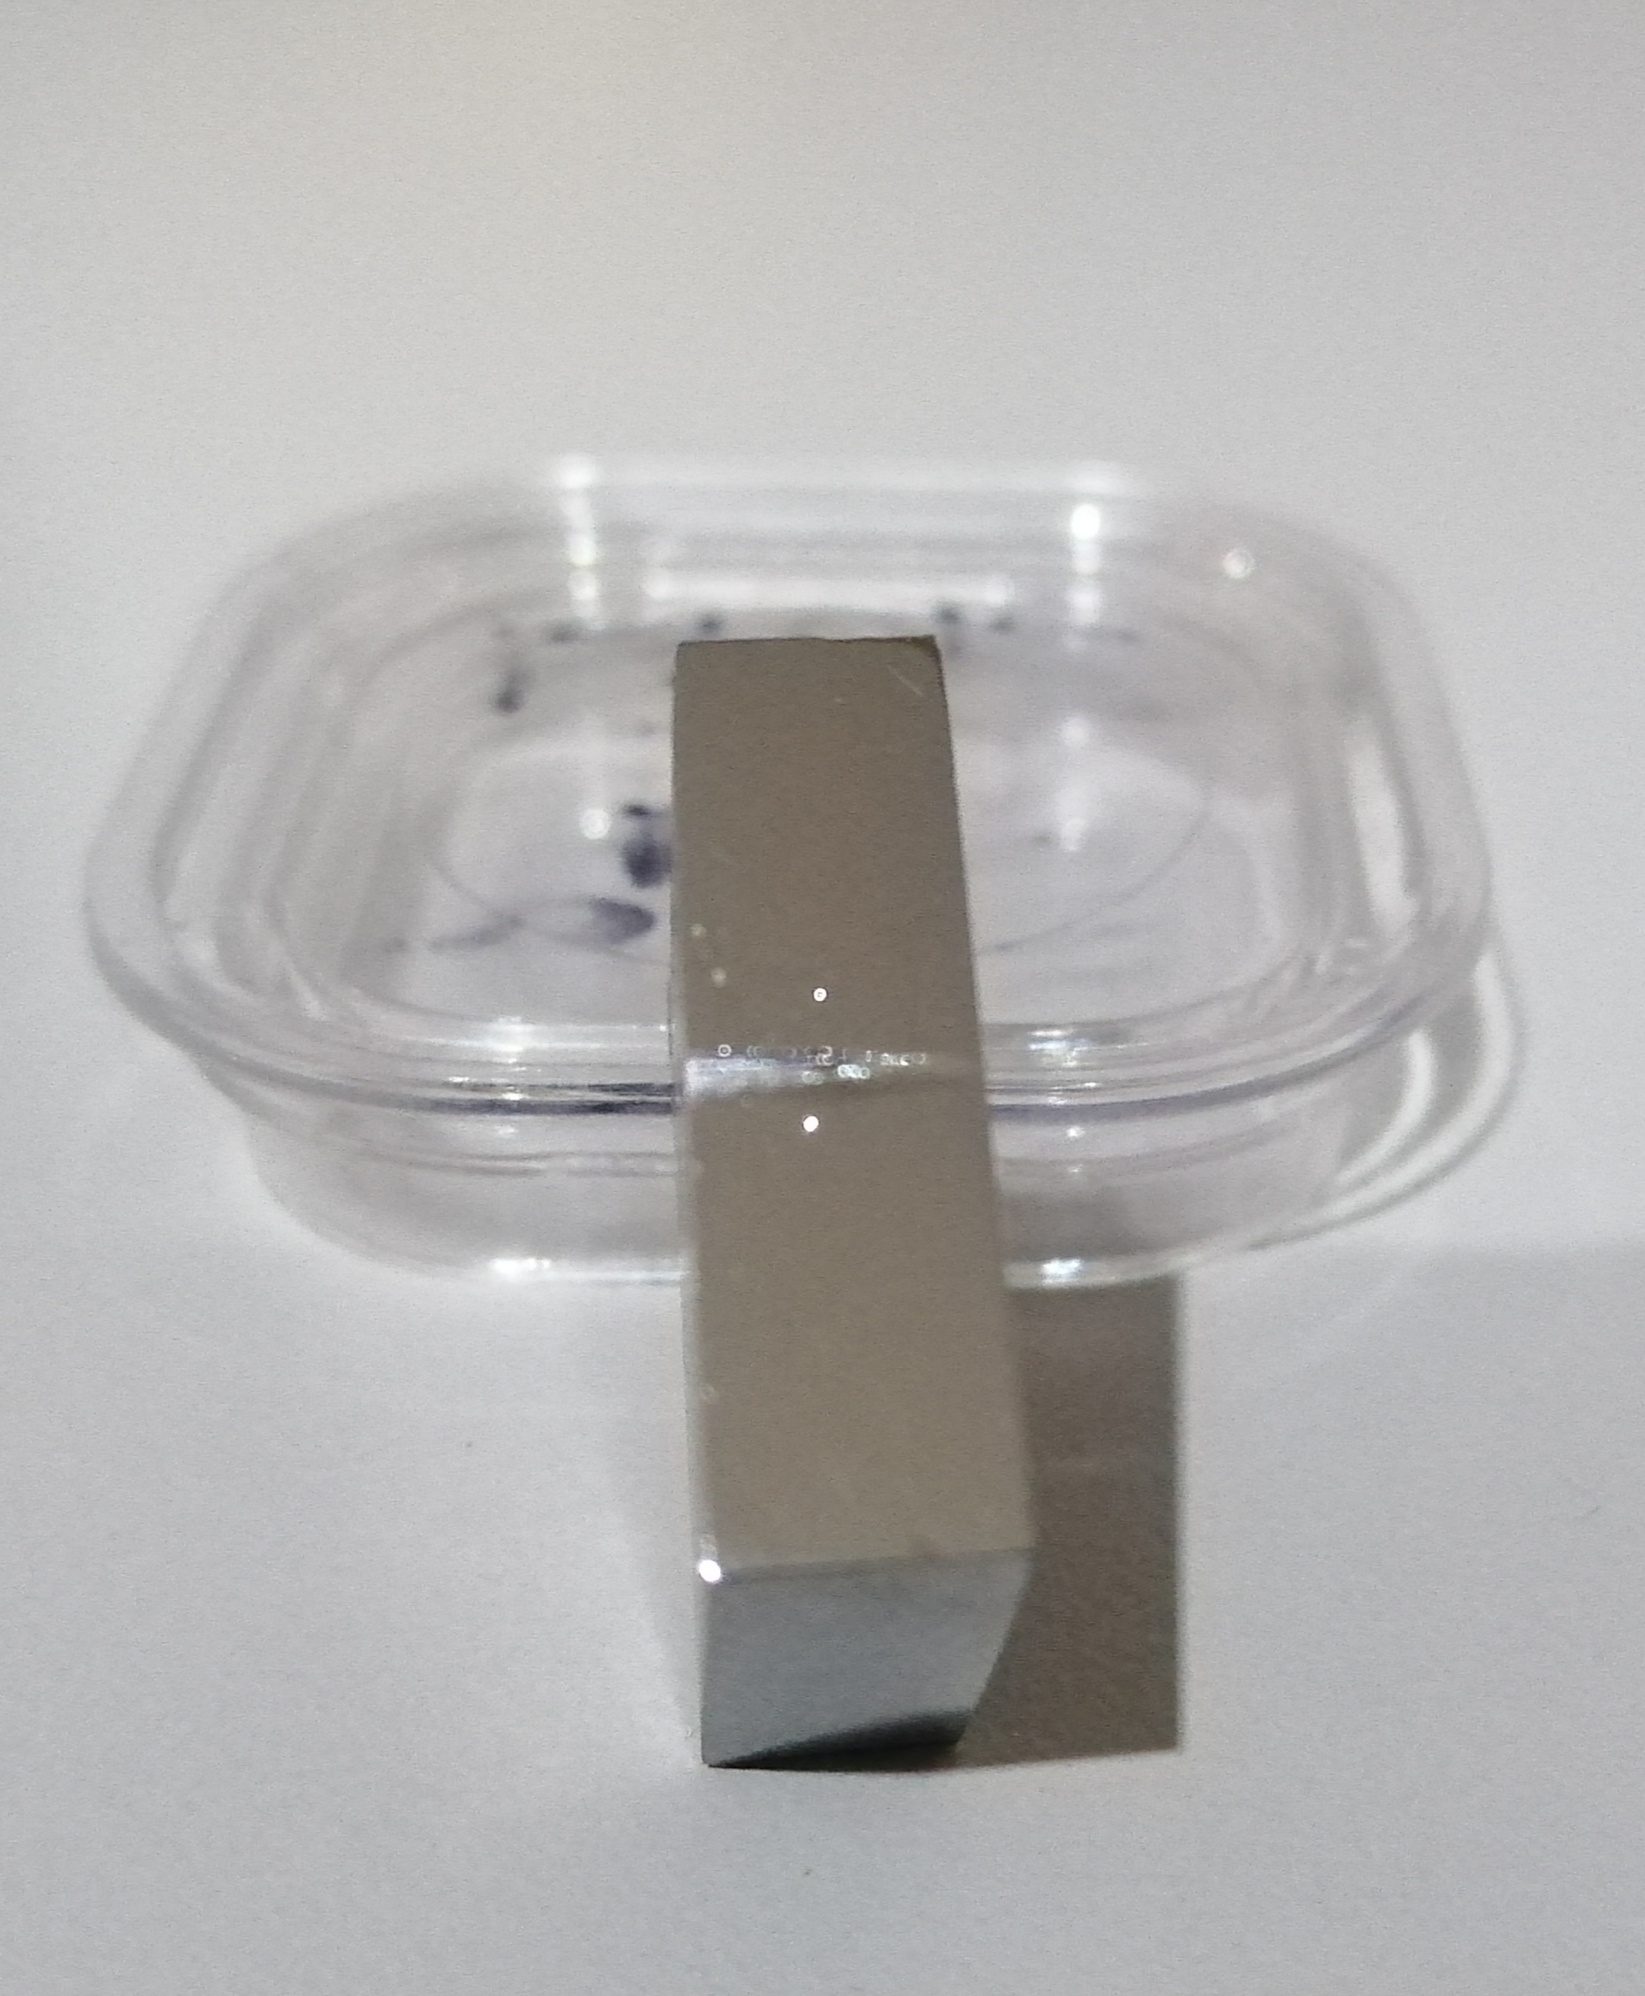
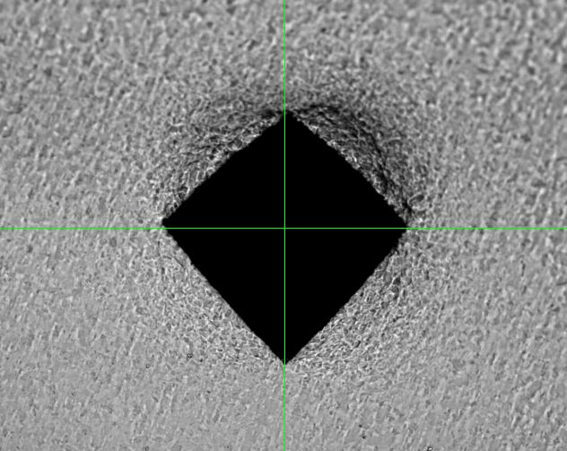
HV10 indent using Struers Durascan 80
auto hardness tester
Attempt with diamond ¼ micron hand-polishing at 10 min intervals

Slide 6
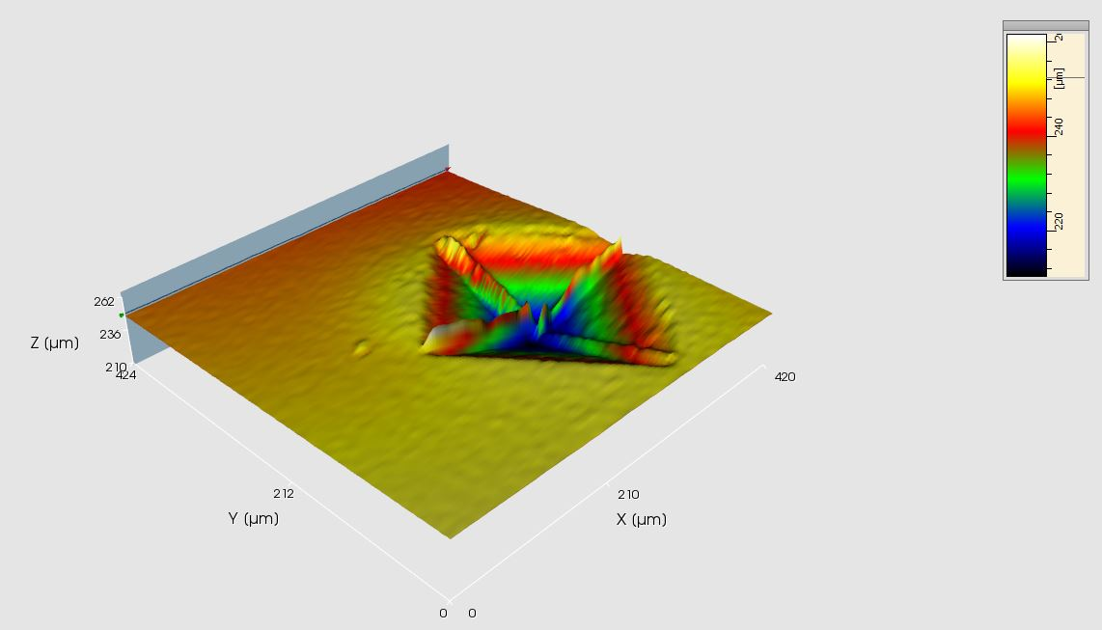
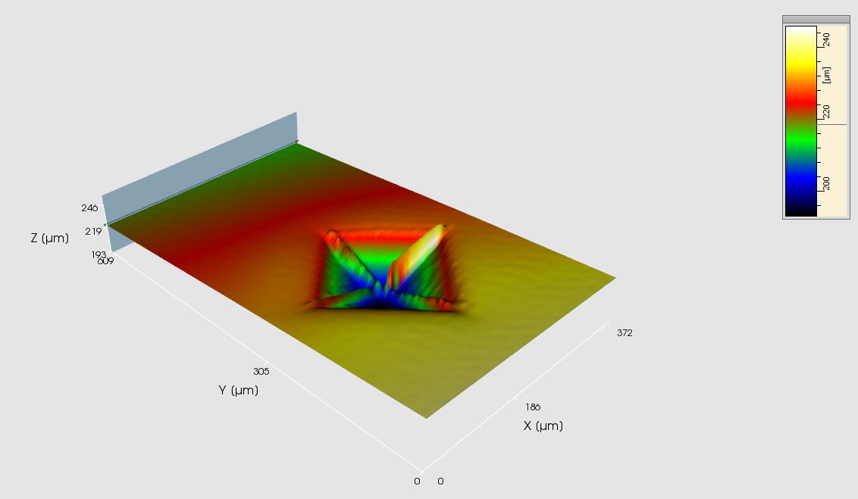
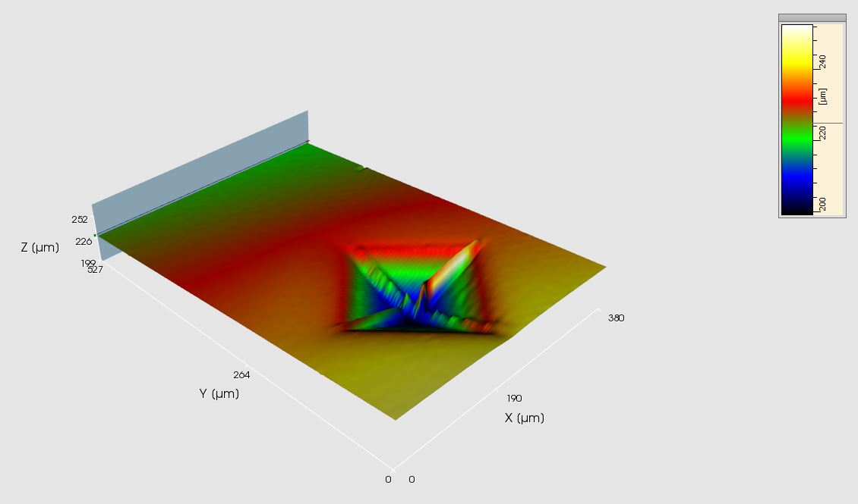
As-indented
10 mins ¼ um hand-polish
Polishing time /mins | Trough height /um | Plane height /um | Difference /um | Removed thickness/um
Profile 1
0 | 211.54 | 250.42 | 38.88
10 | 193.52 | 232.58 | 39.06 | 0.18
20 | 199.4 | 239.22 | 39.82 | 0.76
Profile 2
0 | 218.26 | 250.28 | 32.02
10 | 200.9 | 232.34 | 31.44 | -0.58
20 | 207.46 | 238.76 | 31.3 | -0.14
20 mins ¼ um hand-polish
Again with error of 1.4 um no observable erosion

